Slide 1
My ideal school

Slide 2
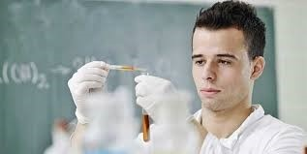
In my ideal school

Slide 3
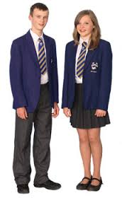
The school uniform

Slide 4

The rules

Slide 5
The timetable
 | Monday | Tuesday | Wednesday | Thursday | Friday
9 10 | PE | PE |  | PE | Chemistry
10 11 | PE | PE |  | PE | Chemistry
11 12 | Maths | Maths |  | Maths | Maths
12 1 | Lunch | Lunch |  | Lunch | Lunch
1h 2 | Lunch | Lunch |  | Lunch | Lunch
2 3 | DT | ICT |  | RE | French
3 4 | Geography | History |  | Music | English

Slide 6

The club

