Slide 1


Slide 2
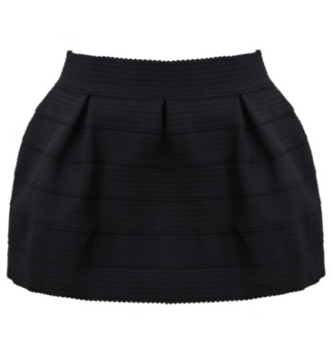
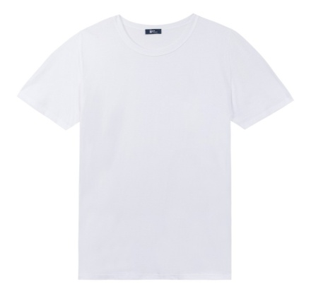
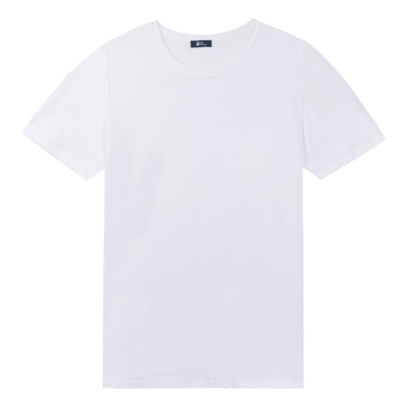
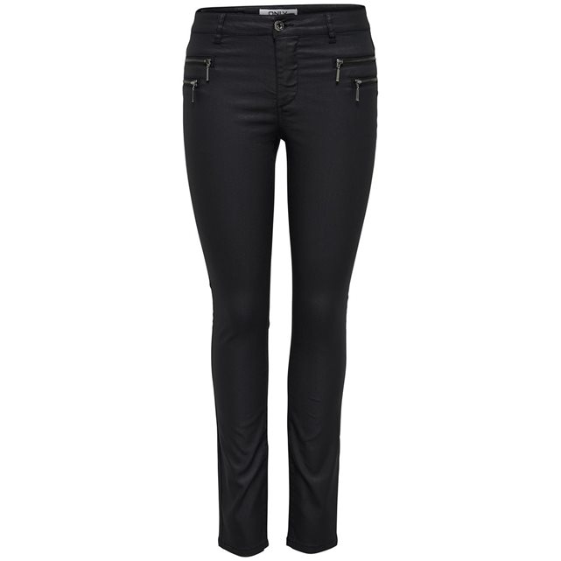
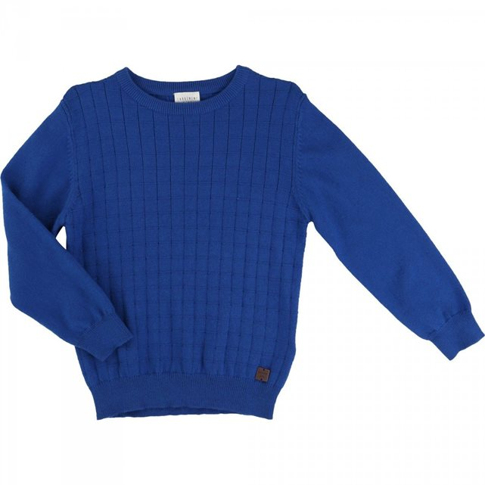
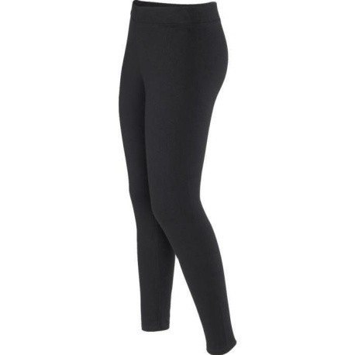
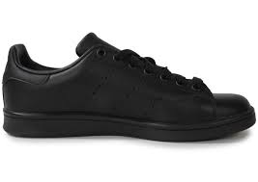
Uniform girls boys

Slide 3
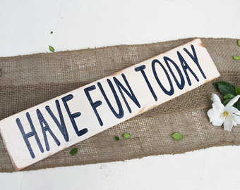


Rules (must / mustn’t)

Slide 4
Time | Monday | Tuesday | Wednesday | Thursday | Friday
9 | math | p.e | art | science | ict
10 | art | ict | math | math | dt
11 | English | French | English | dt | dt
12 | lunch | lunch | lunch | lunch | lunch
1 | lunch | lunch | lunch | lunch | lunch
2 | lunch | lunch | lunch | lunch | lunch
3 | drama | math | ict | science | ict

Slide 5

Spanish Club food,penfriends…

Slide 6


Slide 7
Luna
Salas-Perez
6e6

