Slide 1



Slide 2
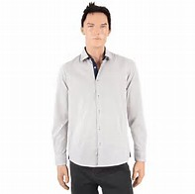

Slide 3
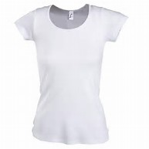
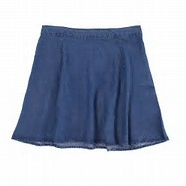

Slide 4


Slide 5
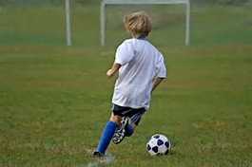

Slide 6
 | 8-9 | 9-10 | 10-11 | 11-12
Monday | French | Physical Education | Physical Education | Physical Education

Slide 7
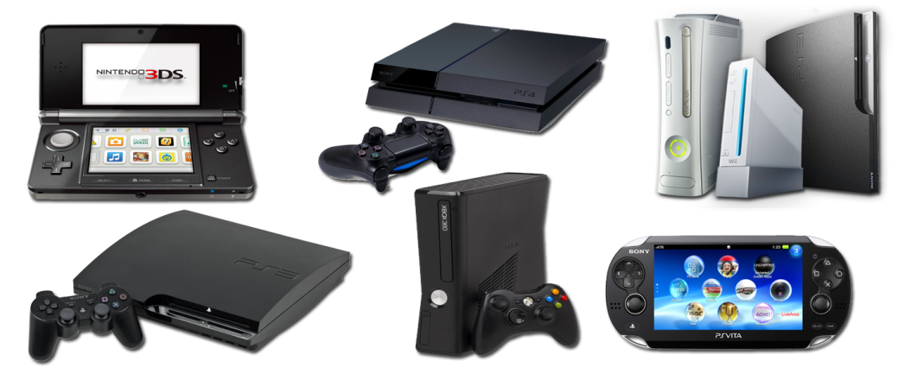
Console Club

Slide 8
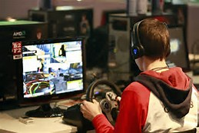

Slide 9
